Slide 1
Clustering NBA Archetypes & Identifying Team Needs
Final Project Presentation
Andrew Gajewski and Tate Whittaker
CS 472 - Unsupervised Machine Learning

Slide 2

NBA Overview
Best basketball league in the world, best players in the world.
On the surface the goal is simple, score more points than the other team.
Teams are comprised of 5 positions: point guards, shooting guards, small forwards, power forwards, and centers.
The deeper you look, the more complex it gets:
  a variety of stats, some straight forward and others complex.
  player positions aren’t always so cut-and-dry.
Notes:
For those who aren’t familiar with the NBA or aren’t hardcore fans like Chandler, the NBA is the best basketball league in the world and is home to the best players in the world.
On the surface, the game is fairly simple. One team is trying to score more points than the other team.
To accomplish this, teams build a roster of 13-15 players. For comprehension sake, these players fit into five categories: point guards, shooting guards, small forwards, power forwards, and centers.
However, the deeper you look into the game the more complex it becomes. There are a variety of stats outside of just scoring (rebounds, assists, steals, blocks, and then advanced stats like player shooting percentages, offensive/defensive ratings, and usage rates).
Player positions aren’t always cut-and-dry. Sometimes, players dip into multiple roles or even stick out and have such unique play styles that they can be labeled anomalies.
This is where we come in!

Slide 3
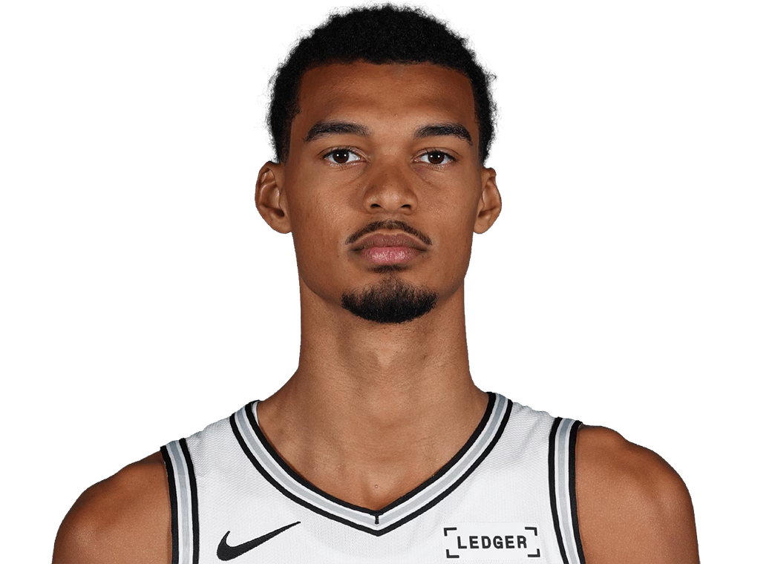
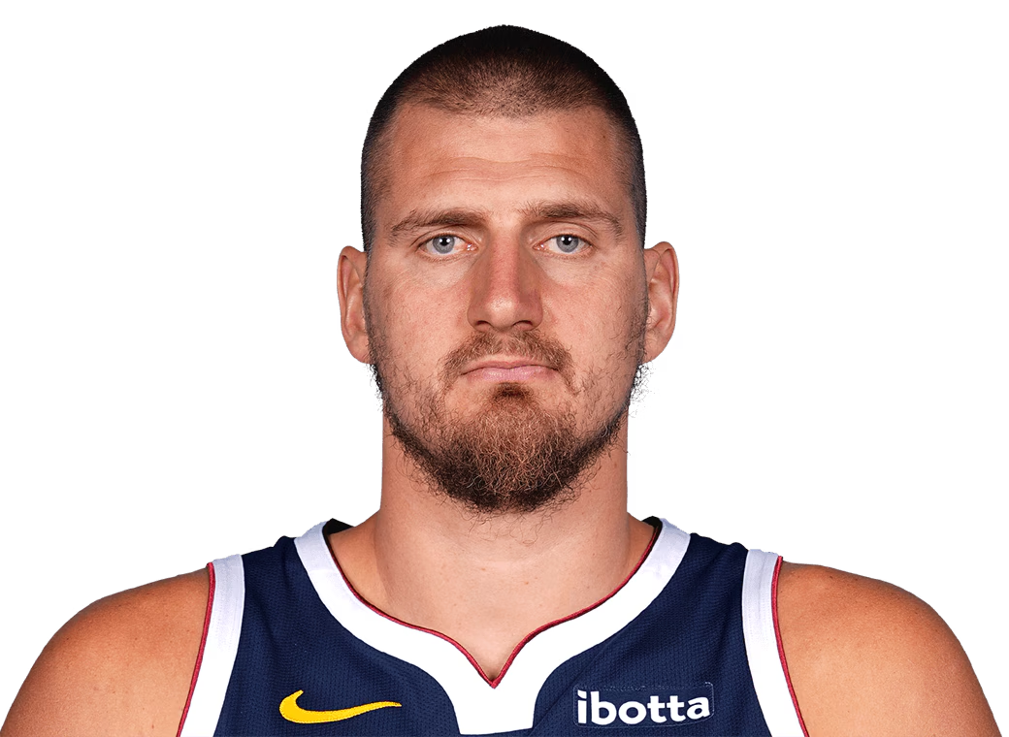
Project Refresh
Our goal is to cluster players and recommend team fits.
We based our project off of prior work: “Mapping the Modern NBA”
We extend existing work with GMM clustering and for players AND teams.
Notes:
Our overall goal is to take player stats from NBA datasets, cluster players based on their playstyles and statistical contributions, then recommend what teams they will be a good fit on from there.
In our previous presentation, we discussed a paper that clustered NBA players into archetypes using K-Means. This paper did a great job of clustering NBA players into roles and archetypes, but it falters a bit in its use of K-means. Because they use the K-Means algorithm, they are hard assigning players to a cluster, when in reality it’s not that simple. In the NBA, roles are often not clear cut and rigid. Oftentimes players will have playstyles that fit multiple different roles.
Our goal is to extend that work by using Gaussian Mixture Models to allow soft clustering. This allows us to assign the players a probability for each cluster, better reflecting the fluidity in roles. Then we are going to use those archetypes to identify team needs and recommend player fits.

Slide 4
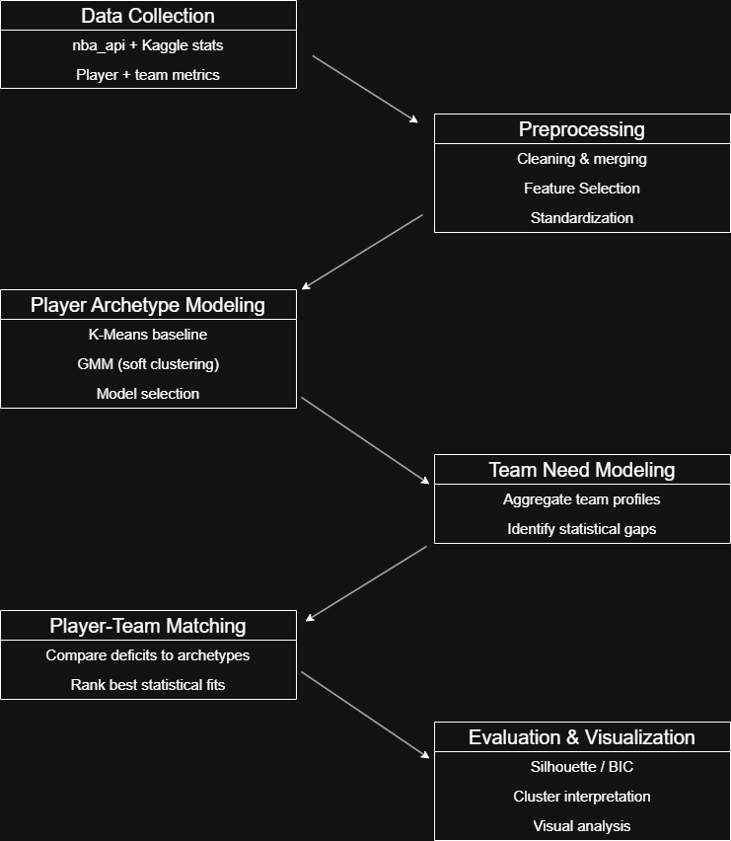

Implementation Update
Notes:
Looking back on our implementation pipeline from our overview presentation, we were able to complete the team need modeling and player-team matching during this second phase.
To reiterate, we completed data collection by pulling three categories of player metrics from the nba_api package: base stats (like points, rebounds, and assists), advanced stats (like usage rate, true shooting percentage, and offensive/defensive rating), and hustle stats (like contested shots, charges drawn, and screen assists).
Next, we moved into preprocessing. We filtered players who played at least 30 games and averaged at least 15 minutes per game in the 2024-2025 regular season. This helps reduce noise from small-sample outliers. The base, advanced, and hustle stats were all in different data frames, so we joined them using PLAYER_ID so we have one row per player. We then dropped any row that had missing values (NA or NULL) in our selected features/columns.
Then we built our feature set AKA the columns that define play style. For example, scoring and shot profile features include points, shot attempts, made shots, and 3pt rate; playmaking included assists and turnovers; defense and physicality included blocked shots, steals, contested shots, and box outs. We also engineered our own features like assist/turnover ratio and 2pt/3pt shot ratio.
Before clustering, we standardized all features using the StandardScalar function (removing the mean and scaling to unit variance). It converts each stat to a z-score relative to league averages. This way, large-scale stats like points don’t dominate small-scale stats like shooting percentages, and each feature contributes to the model fairly. A z-score of 0 means that the feature is within one standard deviation of the league average, a +1 means it’s one standard deviation above, and a -1 means it’s one standard deviation below.
Then we selected k (number of clusters) by testing values 3 to 10 and using BIC/AIC to balance fit and complexity. We chose k with the lowest BIC score, and we also computed silhouette scores as a separation-based sanity check.
We implemented the Gausian-Mixture Model that fits so well with this problem type to produce soft cluster assignments. For this run, we used the diagonal covariance type, meaning the model treats features as independent within each cluster. This is faster and reduces overfitting risk.
Then Andrew took care of the team need modeling by creating team cluster profiles, which give percentages for how many players each team has in a cluster, and a league average cluster distribution to compare it too.
For the player-team matching, we created a team needs table by comparing the team cluster profile to the league distribution and ranked players by how well their cluster probability matched a team’s need.

Slide 5
Live Demonstration

Slide 6
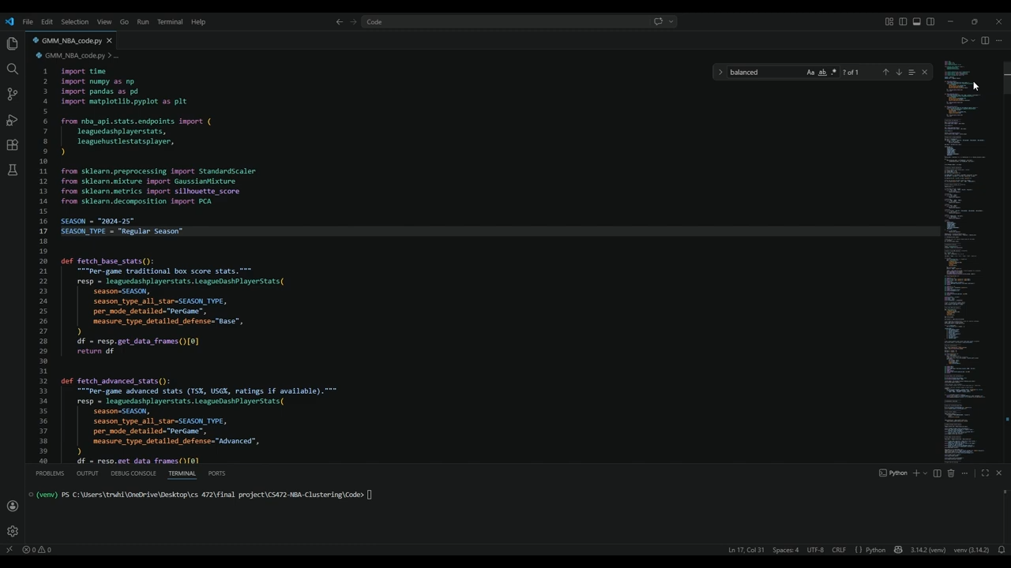

Slide 7
Data & Preprocessing
A lot of the .csv files were visible in the video demonstration (team cluster distribution, league averages, and team needs).
However, the cluster means and player cluster data was not!

Slide 8
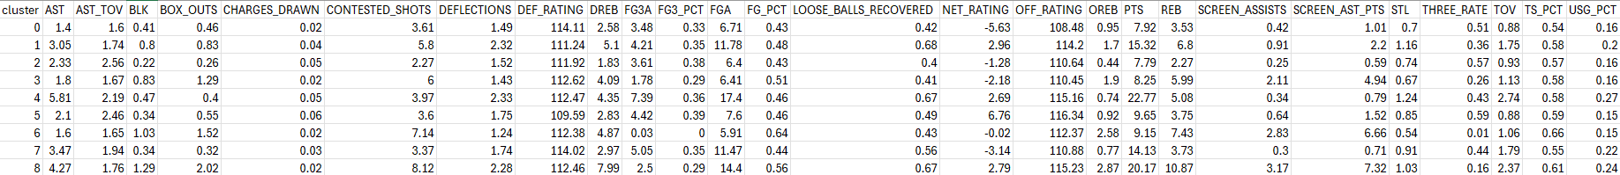
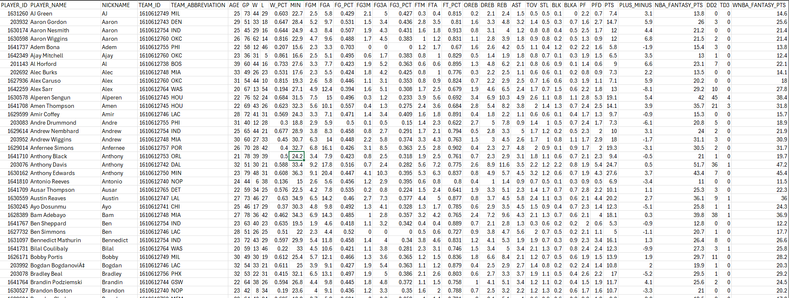
Notes:
These are cluster means data and player cluster data.
The top table shows the averages for each of the 26 features for the 9 clusters. You can see that cluster 4 (superstart cluster) has the highest average points and usage rate.
The bottom table is our player data. We have 322 rows after joining the three datasets from the nba_api package and filtering them. This shows all the relevant player data, as well as the probabilities that each player belongs to 9 clusters.

Slide 9
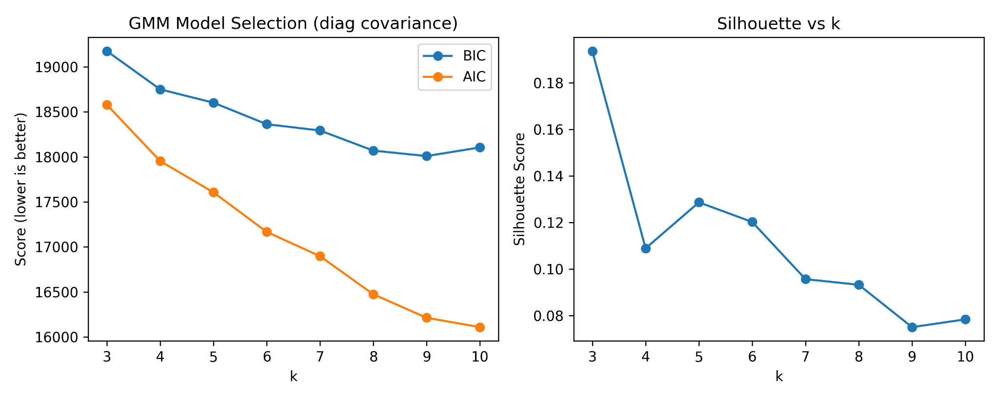
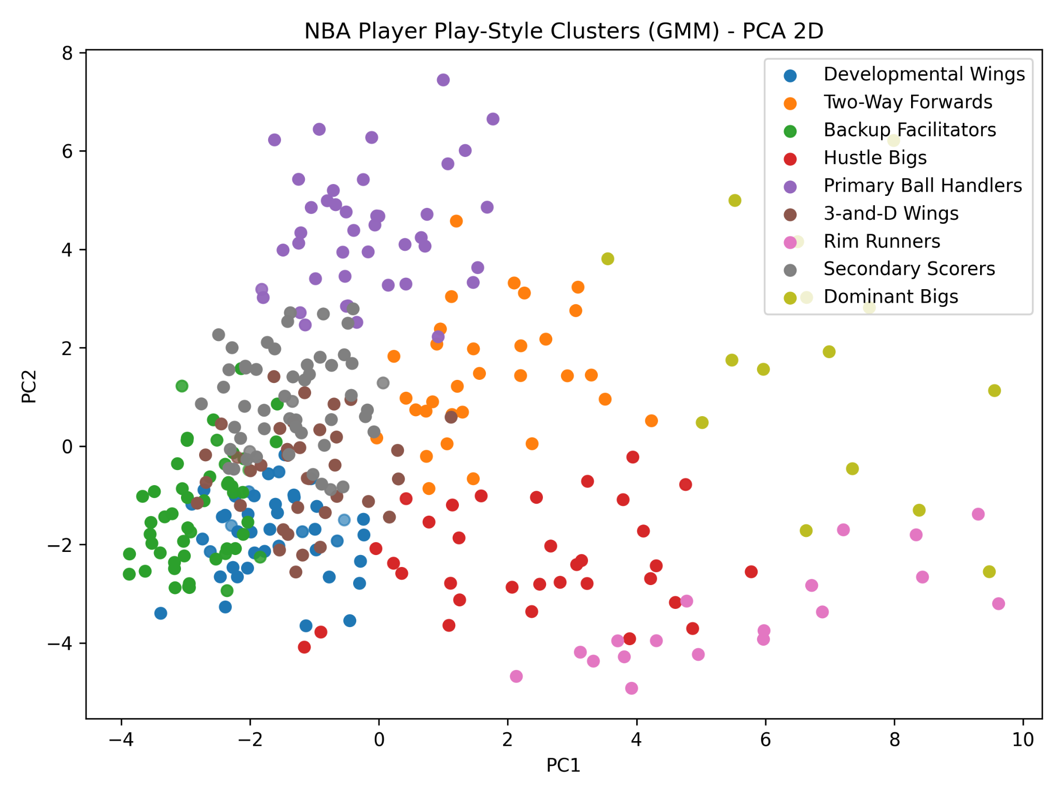
Results
PCA and BIC Graphs
Notes:
At the top we have our model selection results. We tested k from 3 to 10 clusters. BIC and AIC measure model fit while penalizing complexity AKA the balance between fitting the data well without overcomplicating things . BIC is more conservative, and it reached its lowest value at k = 9, so we used 9 archetypes for this run.
The silhouette score is a separation-base sanity check. It tends to prefer fewer, more separate clusters. It is highest at k = 3 and declines as k increases, which makes sense, more archetypes means roles overlap more. We used silhouette as a check, but prioritized BIC for choosing k. It’s also cooler to use more clusters to see where players fall in a wider spectrum.
At the bottom is our archetype map of the league. Each dot represents one player in the 2024-2025 season, and the color shows which cluster the GMM assigned them to.
One the bottom is our PCA map. We started with 26 stats per-player (scoring, shooting, playmaking, rebounding, defense, hustle, advanced, etc.) PCA compresses those 26 dimensions down to two axes so we can easy visualize it.
That means that PC1 and PC2 aren’t individual stats, they are weighted combinations of stats that capture the biggest patterns in the data.
We are looking for reasonably distinct regions, and you can see some pretty clearly. On the other hand, others overlap. This overlap is expected though, roles blend in basketball. Again, this is why we prefer GMM because it handles hybrid players by giving probabilities rather than forcing a single hard label.
One important note, PCA is only for the picture. The actual clustering was done in the full 26-feature space.

Slide 10
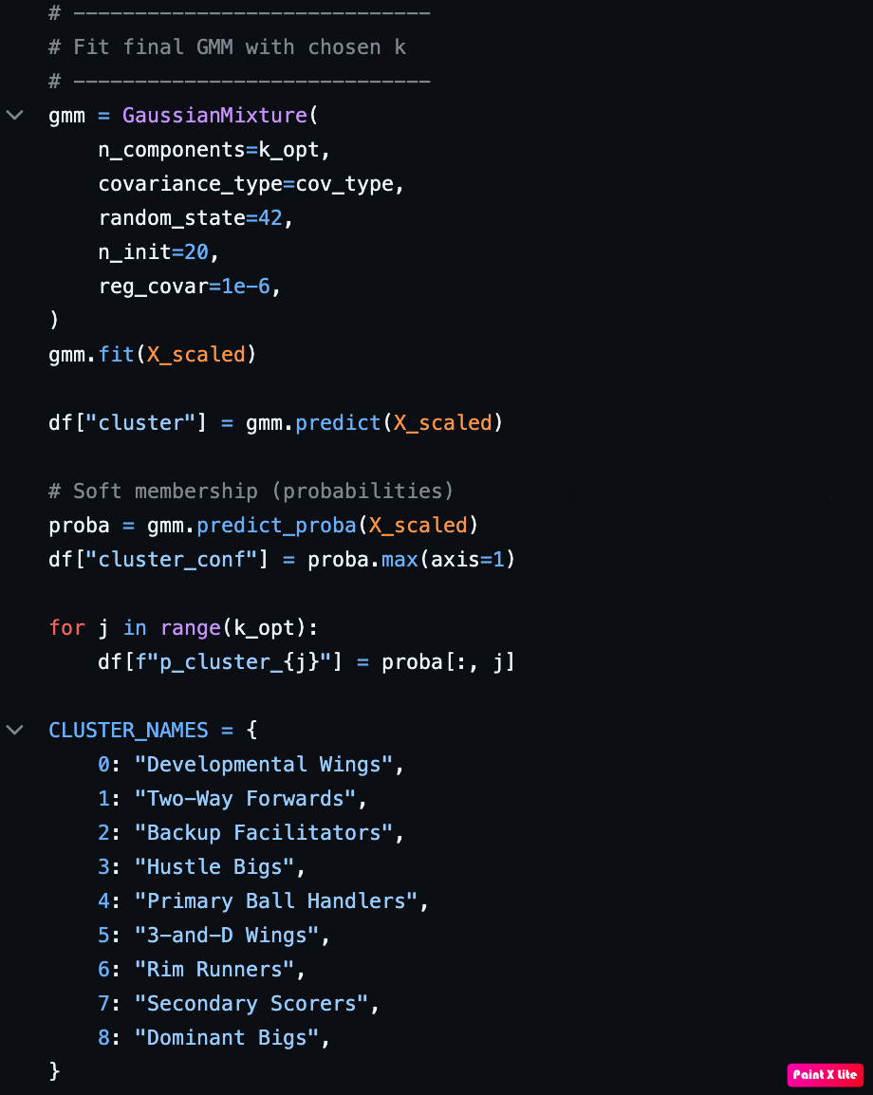
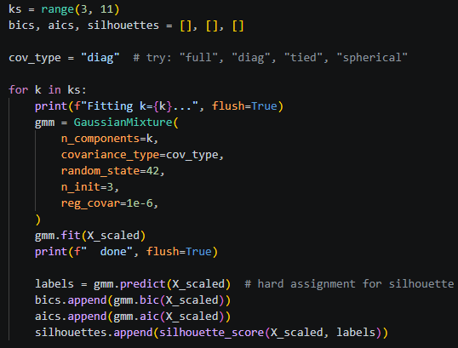
Code Snippets
Player Archetype Clustering
Notes:
This slide shows the core clustering portion of our implementation.
After selecting the number of clusters with the BIC score and fitting the final model, each player was assigned a cluster. Since GMM is a soft clustering method, we also stored each player’s probability of belonging to each cluster. That gave us more information than a standard hard clustering approach, because some players can be treated as hybrid archetypes.
Finally, we mapped the numeric cluster labels to readable basketball archetype names, like Primary Ball Handlers, 3-and-D Wings, Rim Runners, and Dominant Bigs.

Slide 11
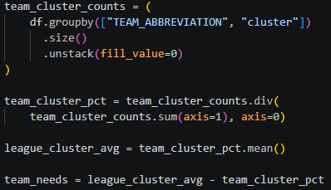
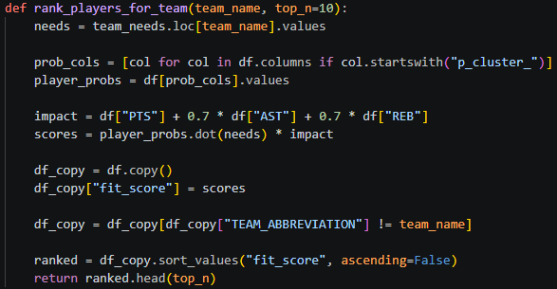
Code Snippets
Team Needs & Player Fit
Notes:
After clustering players, we used those clusters to model team needs.
First, we grouped each team’s roster by cluster to see what archetypes each team already had. Then we converted those counts into percentages and calculated the league-average cluster distribution. This gave us a baseline for what an average NBA roster looks like by archetype.
From there, team needs were calculated by subtracting each team’s cluster percentages from the league average. If a value is positive, that team is below league average in that archetype, so it is treated as a need. If the value is negative, the team already has a surplus of that archetype.
The final function ranks players for a selected team. It compares the player’s cluster probabilities to the team’s need vector using a dot product, then weights that by basic production using points, assists, and rebounds. We also filter out players already on the selected team. The result is a ranked list of players who best match that team’s archetype gaps.

Slide 12
Links
GitHub Pages: https://dr3w-mg.github.io/CS472-NBA-Clustering/
GitHub Repository: https://github.com/dr3w-mg/CS472-NBA-Clustering

Slide 13
Questions?

